Slide 1


Data API Builder
Create an API for your database in seconds
Jess Pomfret · Data Bristol 2026
Notes:
Welcome. I'm Jess. Today we're going to talk about Data API Builder — but I'm going to start with a story.

Slide 2



Jess Pomfret
(She/Her)
Data Platform Engineer
LinkedIn Learning Instructor
Open Source Contributor
dbatools, MicrosoftFabricMgmt
Passionate about Automation, Proper Football & Fitness
jpomfret7@gmail.com
jesspomfret.com
linkedin.com/in/jpomfret/

Slide 3
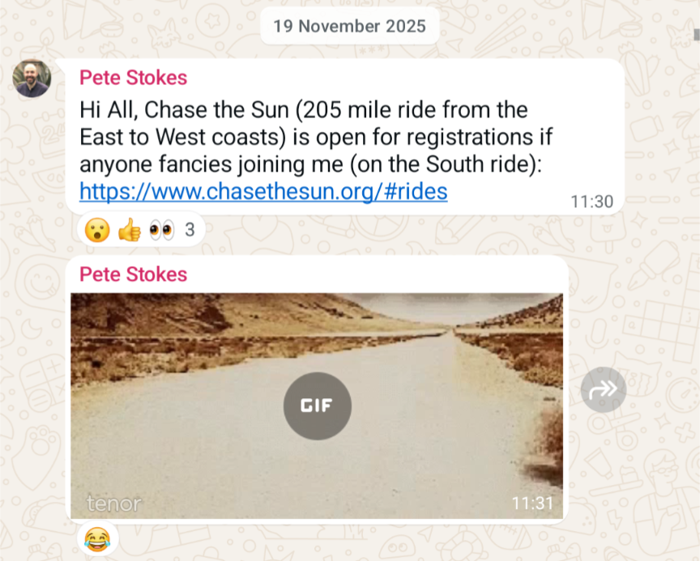
if I wanted to cycle 205 miles in one day…
One day someone asked
Notes:
Last November I got a text message in a gym cycling group
Pete said ‘hey does anyone want to do this’ … and I thought – what a terrible idea, absolutely not…
And then…
Wait a min….
That’s the gif of a tumbleweed…

Slide 4
On 20th June 2026, I set out to cycle 205 miles… in one day!
Notes:
Big number, sets up the bet. Pause. Let it land.
what a great plan 🤣
In 30 days time

Slide 5
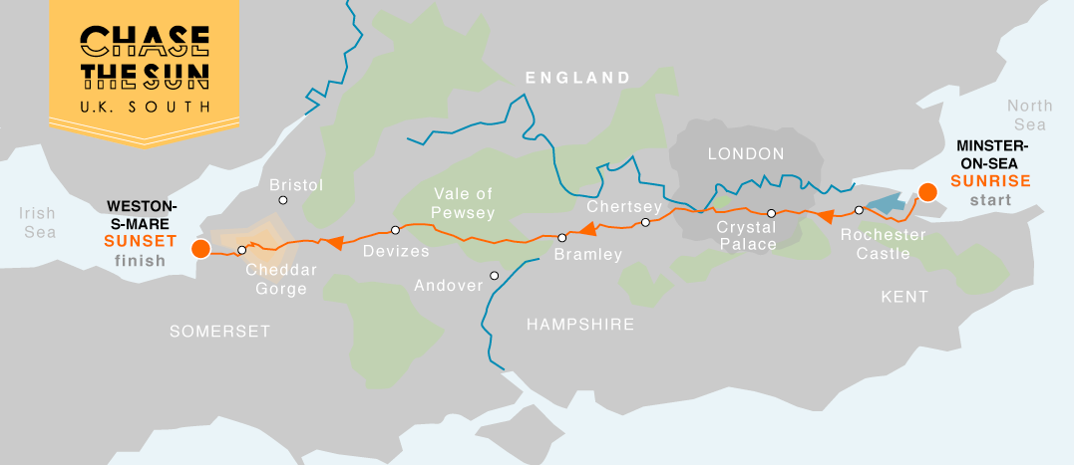
Chase the Sun 2026
205 miles. Minster-on-Sea to Weston-Super-Mare
Sunrise to sunset. One day. Coast to coast.
3 days after my 40th birthday.
Notes:
3 days after my 40th birthday – midlife crisis anyone?

Slide 6




The Problem?
Getting to the start line. Trained. Fuelled. Ready
Notes:
It’s also worth saying that I have a somewhat addictive personality – which tends to mean when I’m in… I’m all in….

Slide 7
This generated a lot of data
Wellness, fitness, fueling.
Many devices. Many Apps. No shared view. No way to query it together.
I'm a data nerd. I want it in my database.
Notes:
This has generated a lot of data – and I thought what better way to procrastinate writing this presentation… than building something to solve a real problem, while showing how cool DAB really is – so here we are!
And when I say there has been a lot of data…

Slide 8
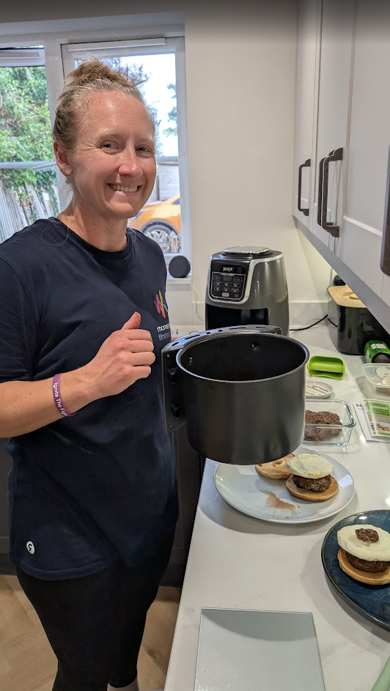
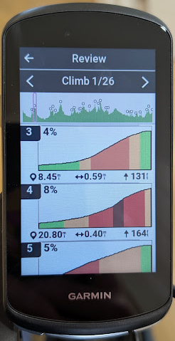

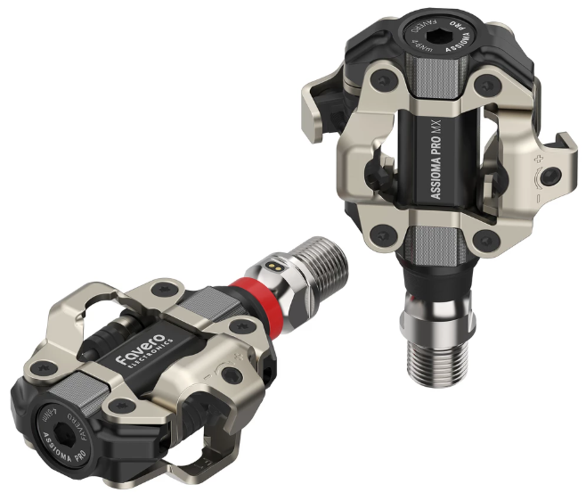
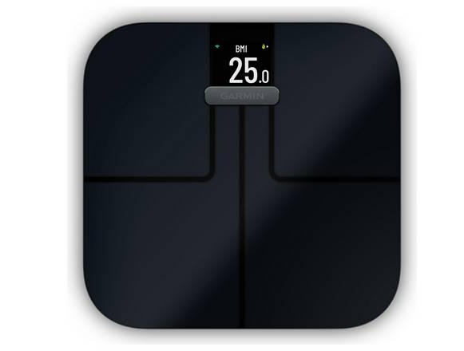
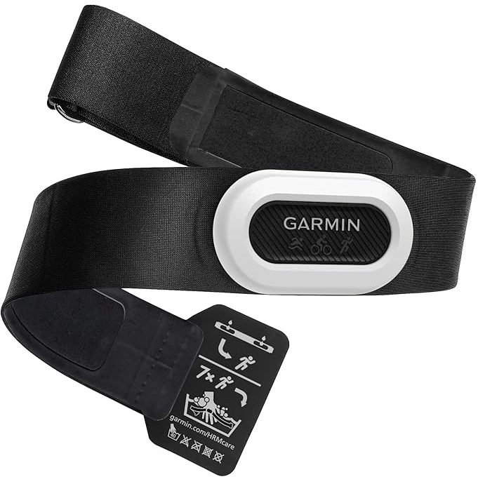
No… like A LOT of data
Notes:
We’ve got sleep stats, heart rate, heart rate variability, body battery, recovery, training readiness all coming from my Garmin watch
Weight and body comp stats coming from my Garmin Scale
And We’ve got bike ride data coming from a Garmin edge head unit – distance, speed, maps of where I’ve been
+ HR strap for more accurate HR reading
+ power pedals – how much force I’m putting through the pedals
And we’ve got weights and calories of all the food that my wife is cooking, and I’m busy eating…
The last few months have been a lot of cycling, eating, recovering… and obviously working (literally my whole team is here shh)
Heart rate, sleep, HRV, RPE, distance, speed, power, fueling
Heart Rate Variability (HRV) is the measure of the variation in milliseconds between consecutive heartbeats
Rate of Perceived Exertion (RPE) is a subjective 1–10 scale

Slide 9
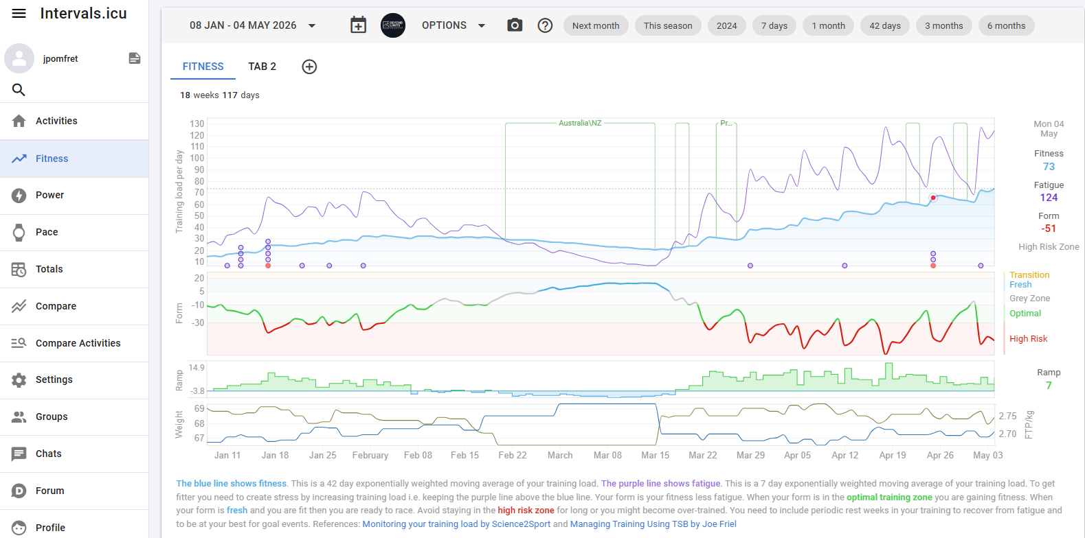
Intervals.icu
Notes:
So most of this data goes via Garmin into intervals.icu a great open source tool for training data
They have all kinds of metrics, and explanations on metrics
And all kinds of graphs – this top one is fitness vs fatigue, basically if you keep the purple fatigue line above the blue fitness line your fitness will increase
You can see the opposite happened while I was in Australia
But too much training is bad, so also aim to keep this form line close to green…
You can also plan your training here, chat to other cycling nerds, but nothing for weight\nutrition

Slide 10
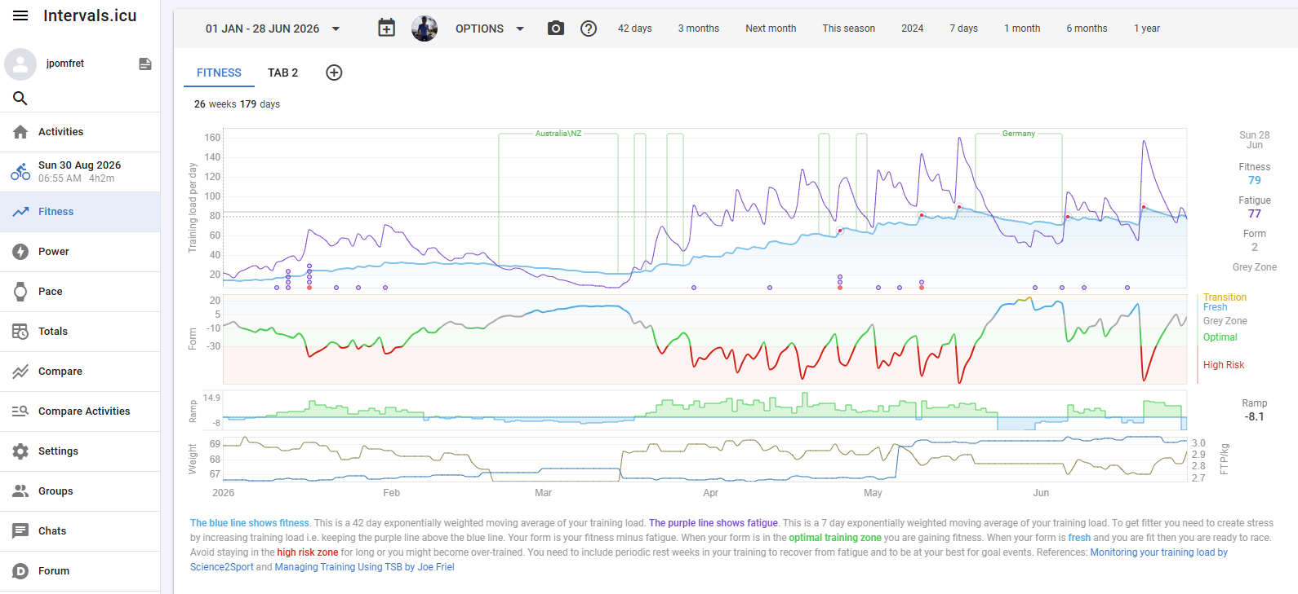
Intervals.icu
Notes:
So most of this data goes via Garmin into intervals.icu a great open source tool for training data
They have all kinds of metrics, and explanations on metrics
And all kinds of graphs – this top one is fitness vs fatigue, basically if you keep the purple fatigue line above the blue fitness line your fitness will increase
You can see the opposite happened while I was in Australia
But too much training is bad, so also aim to keep this form line close to green…
You can also plan your training here, chat to other cycling nerds, but nothing for weight\nutrition

Slide 11
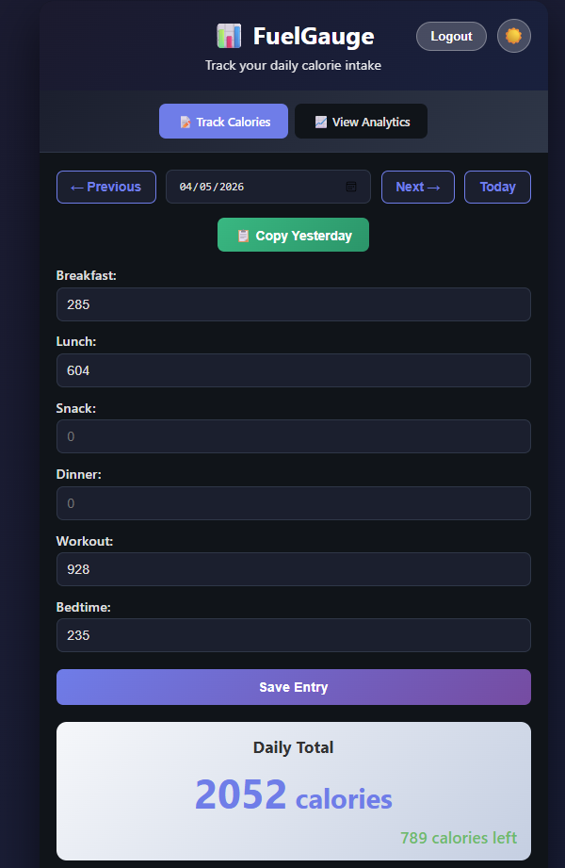
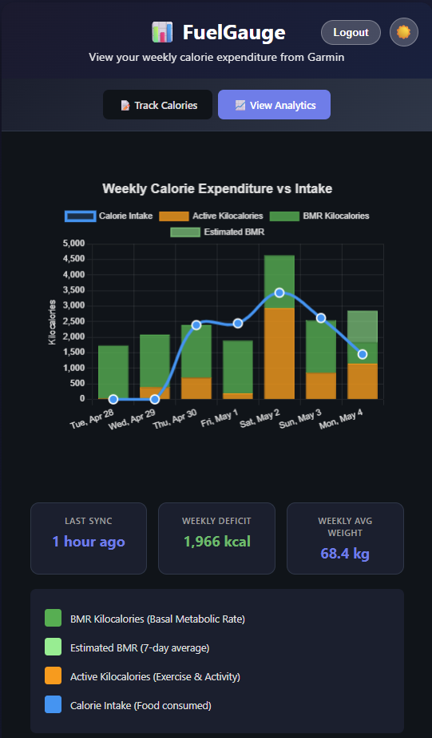
FuelGauge
Home grown app
Tracks Calories Consumed
Compares to Calories Burnt
Stored in postgres & influx databases running on Kubernetes (don’t ask)
Notes:
So I built my own simple app
And then I built my own app to track my calories consumed, it pulls in data from Garmin for my daily calories burned to make sure I’m eating enough \ not eating too much

Slide 12

One place. One way in. One way out.
Everything in SQL Server.
PowerShell writes to it.
A dashboard reads from it.
I do not want to write a backend.
Notes:
I want to collect my data – load it into my Azure SQL Database – we’ll use Data API Builder as the API layer
We can use DAB to create GET and POST endpoints – meaning we can get and set data using this – and it’s so simple to get it set up

Slide 13
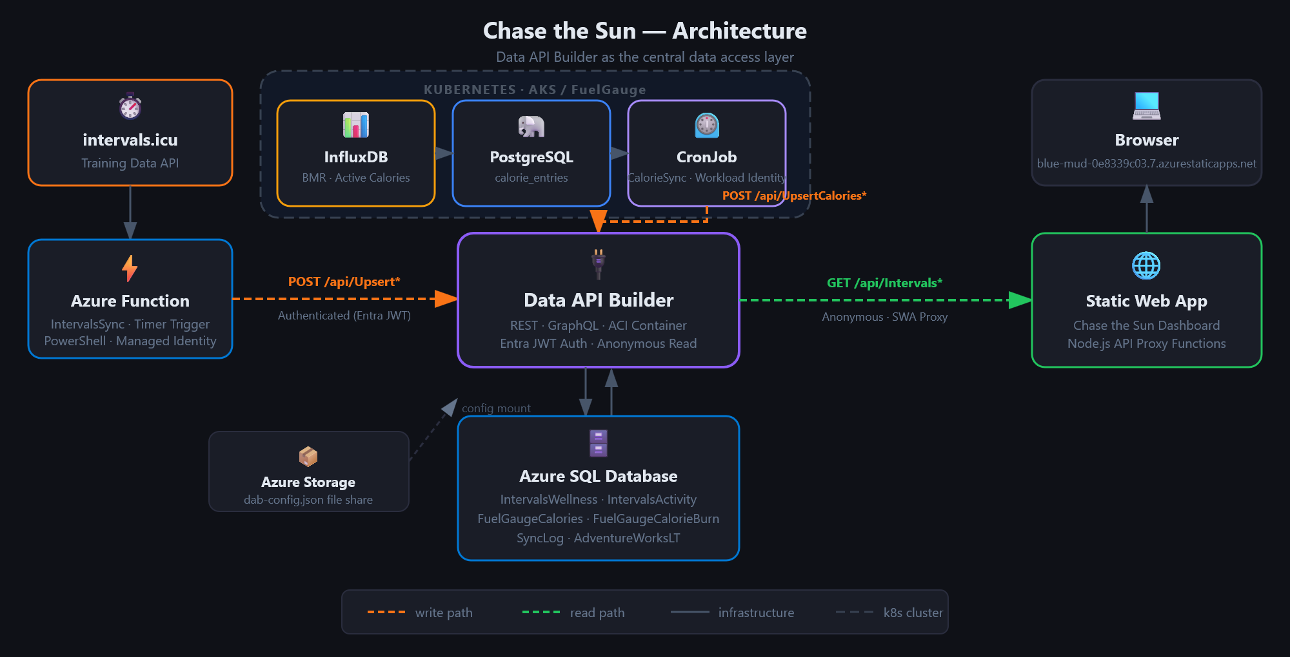

Slide 14
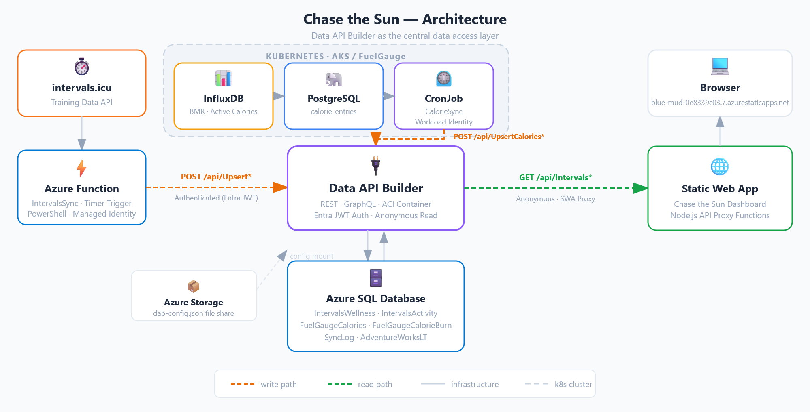
Notes:
So I created this… monstrosity
We’ll come back and talk more about this later on – but for now notice we have an Azure SQL Database, with Data API Builder sat in the middle as our integration layer

Slide 15
Notes:
And since the presentation I have promised you is all about DAB and not all about cycling and fueling – lets talk about that

Slide 16
What is Data API Builder?
Notes:
10 mins
Ok so remember why we’re here… DAB not Jess’ cycling adventure
What is it?

Slide 17
What is DAB?
A config-driven REST, GraphQL & MCP (preview) layer over your database.
Point it at SQL Server, Postgres, MySQL, or Cosmos DB.
It serves your tables, views, and stored procs over HTTP.
No backend code. Just configuration.
Notes:
Basically create a simple config file in JSON
Tell DAB about the config file
API magic
It’s that easy
The GraphQL stuff is great, the MCP stuff is in preview, coming soon – both neat but today we will focus on REST API

Slide 18
Architecture
SQL Server
(or Postgres)
DAB
(config-driven)
REST + GraphQL
endpoints
One config file describes which entities are exposed and how.
Notes:
Simplest setup – we have a database, we have DAB running in a container say, and then we can access the endpoints

Slide 19
The config file
One JSON file. Two important parts: data source and entities.
{
"data-source": {
"database-type": "mssql",
"connection-string": "@env('DATABASE_CONNECTION_STRING')"
},
...
"entities": {
"IntervalsWellness": {
"source": {
"object": "dbo.IntervalsWellness",
"type": "table"
},
"permissions": [{ "role": "anonymous", "actions": ["read"] }]
}
}
}
Notes:
Simplest form of config
Using an environment variable for the connection string
Exposing one table for read (GET) access with no authentication
The name of the entity ‘IntervalsWellness’ in this example will become the API endpoint

Slide 20
Demo: dab in 2 mins
Notes:
13.5 mins – 21.5 mins
After demo
So you can see how easy it is to get started with DAB locally
And in a container… and that’s part of what makes DAB so easy to get going
- But it’s also got some cool baked in features out of the box

Slide 21

Deployment
One container image.
Multiple ways to run it.
01
Docker container
Single image, runs anywhere — local dev, CI pipelines, or bare-metal servers. Just point it at your database.
02
Azure Container Apps
Serverless container hosting with auto-scale. No cluster to manage. Pay only for what you use.
03
Azure App Service
Managed PaaS with built-in auth, custom domains, and deployment slots. Familiar to any .NET team.
04
Azure Kubernetes (AKS)
Full orchestration if you already run K8s. Helm chart included.
Fits into your existing cluster.
All options use env vars or JSON config
Zero code changes between environments
Notes:
How do we productionise? Well that container setup makes it really easy to deploy to the cloud
I just showed you option 1
Docker container:
- The DAB runtime ships as a single Docker image from Microsoft Container Registry.
- docker run is all you need for local development — pass your connection string as an environment variable.
- Same image works in CI pipelines for integration testing — spin it up, run tests, tear it down.
- For bare-metal or VM deployments, just run the container directly. No framework dependency on the host.
Azure Container Apps:
- Recommended starting point for most teams. Serverless — you don't manage infrastructure.
- Built-in auto-scale from zero to N replicas based on HTTP traffic. You pay per request, not per VM.
- Supports revision-based traffic splitting for canary deployments.
Azure App Service:
- If your team already runs .NET apps on App Service, DAB slots right in.
- Deployment slots give you blue-green deployments out of the box.
- Built-in auth integration with Entra ID (formerly AAD) — no code changes needed.
Azure Kubernetes Service (AKS):
- For teams that already operate a K8s cluster. Helm chart is provided.
- Fits into existing service mesh, observability, and scaling policies.
- Most operational overhead — only choose this if you already have the K8s muscle.
Key message: identical image everywhere. The only thing that changes between environments is the config — connection strings, auth settings, CORS rules. All of that lives in environment variables or a JSON config file, never in source code. Connection strings should be stored in Azure Key Vault and referenced via env vars.

Slide 22
Run it anywhere
dab CLI locally. Docker image everywhere else. Same config, same behaviour.
# local
dab start --config dab-config.json
# container
docker run -p 5000:5000 `
-v ${PWD}:/App/configs `
-e DATABASE_CONNECTION_STRING `
mcr.microsoft.com/azure-databases/data-api-builder
Notes:
Or you can run it locally

Slide 23
Invoke-RestMethod is all you need
$base = 'http://localhost:5000/api'
# write a row
$body = @{ date = '2026-05-04'; type = 'Ride'; tss = 84 } | ConvertTo-Json
Invoke-RestMethod "$base/Activity" -Method POST -Body $body `
-ContentType 'application/json'
# read it back
Invoke-RestMethod "$base/Activity?\$filter=type eq 'Ride'" |
Select-Object -ExpandProperty value
Notes:
demos

Slide 24
Pagination
$first — limit results to N items per page. Default is 100.
$after — cursor-based pagination. Pass the continuation token to get the next page.
No offset-based paging — cursors are efficient on large datasets.
Response includes hasNextPage and endCursor.
GET /api/Activity?$first=25&$after=eyJpZCI6MTAwfQ==
Notes:
DAB has some pretty advanced features built in too – remember we’re writing no code for this integration layer – just grabbing a container image, and providing some json config.
And built in we get stuff like paging results – we don’t want to overwhelm clients receiving this data – so chunk it into pages
First 25 records
After the record with id 25 - that’s base encoded
Offset-based paging means the database has to skip more rows each time and so gets slower and slower
Cursor-based paging jumps straight to the point in the index, id > 25 and then grabs the next 25 rows

Slide 25
Filtering & querying
$select — return only the fields you need. Less data over the wire.
$filter — OData-style expressions: eq, ne, gt, lt, contains, startswith.
$orderby — sort ascending or descending on any exposed column.
GET /api/SyncLog?$filter=Source eq 'IntervalsSync'&$orderby=RunAt desc&$first=10
Notes:
Filtering & querying — the built-in query surface
$select:
- Project only the columns you need. Reduces payload size over the wire.
- Particularly useful for wide tables — instead of returning 40 columns, pick the 5 you need.
- Example: $select=date,distance,tss returns only those three fields.
$filter:
- OData-style filter expressions on any exposed column.
- Supports: eq, ne, gt, ge, lt, le, contains, startswith, endswith.
- Combine with AND/OR logic: $filter=type eq 'Ride' and distance gt 50.
- DAB translates these to parameterised SQL — no injection risk.
$orderby:
- Sort on one or more columns: $orderby=date desc, distance asc.
- Sorting happens server-side in the database — not in memory in the API layer.
- Default sort order is by primary key if $orderby is not specified.
Key point for the audience: these are standard OData query parameters. If anyone has used Power BI, Dynamics, or any Microsoft data API, the syntax is identical. No learning curve.
The REST endpoint and the GraphQL endpoint both support filtering. REST uses query-string parameters; GraphQL uses typed filter arguments in the schema.

Slide 26
Authentication
Plug in your identity provider
Entra ID, EasyAuth, any JWT server, or Simulator for dev.
Role-based access control
Anonymous + Authenticated system roles, custom user roles, one effective role per request.
Database policies
Row-level security filter results. Claims flow to SQL session context.
Notes:
This is a big topic – and vital if you’re going to take DAB and use it with your production data - this is a getting started session – but I do want to highlight that…
DAB delegates authentication to your identity provider and validates the tokens it receives. Four provider options cover every scenario:
EntraID / AzureAD – JWT bearer validation with extra signing-key issuer checks specific to Microsoft Entra tokens. Configure audience and issuer in the host section. Supports managed identity for the database connection.
AppService (EasyAuth) – App Service handles the OAuth flow and injects the X-MS-CLIENT-PRINCIPAL header. Works with Microsoft, Google, Facebook, Twitter, and OpenID Connect. No jwt.audience or jwt.issuer settings needed.
Custom JWT – Any standards-compliant JWT server (e.g. Keycloak, Auth0, Okta). You supply the audience and issuer.
Simulator – Treats all requests as authenticated without validating a real token. Development and testing only.
Authorization is role-based. Every request resolves to exactly one effective role. Two system roles (Anonymous, Authenticated) are auto-assigned; custom roles map to token claims via the X-MS-API-ROLE header.
Database policies add row-level filtering – predicates are injected into queries so users only see authorised records. Token claims can also be passed to the SQL session context for stored-procedure or trigger-level logic.
Key detail: DAB validates the user token but connects to the database with its own credentials (managed identity or SQL auth) by default. On-Behalf-Of (OBO) is optional if you need the database to authenticate as the actual caller. Secrets can be stored in Azure Key Vault and referenced via @akv() in the config.

Slide 27
Demo: Chase the Sun tracker
Notes:
26 mins
So lets go back to our more complicated example – how this might look in a production setup

Slide 28
Notes:
Ok so back to the center of this project I built – DAB
How have I taken it from what we saw locally that was simple, and so easy to setup and moved it to be production ready
Well that container, with the mounted config file… that’s how
We now know what data api builder is – and how we can set it up
Lets zoom out and look at how we’re using that

Slide 29
Notes:
So we have the DAB container deployed to an Azure Container App
The most important part of DAB… the config file – that’s hosted in an Azure file share in a storage account
How do you update DAB config? Update the json, upload to file share, restart container…done

Slide 30

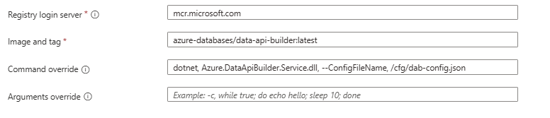
DAB in a container
Official image.
Azure Container App.
MSI auth.
Config from file share.
01
Container image
mcr.microsoft.com/azure-databases/data-api-builder:latest
Microsoft’s official image. No Dockerfile, no build step.
02
Managed identity
System-assigned MSI authenticates to Azure SQL.
No passwords in config, no secrets in code.
03
Config from file share
dab-config.json lives in an Azure File Share, mounted to /cfg. Update config without rebuilding the container.
Notes:
Azure Container App
Deployed from Microsoft registry
Overwriting where the config file can be found
Note about :latest – vs tie to a version

Slide 31
Notes:
Lets look at what’s interfacing with DAB

Slide 33
Notes:
First I have an Azure Function
Now Azure Functions are super cool – basically serverless bits of PowerShell or .NET or python, or basically whatever language you want – running in the cloud.
Cheap, easy to build & deploy, magical

Slide 34
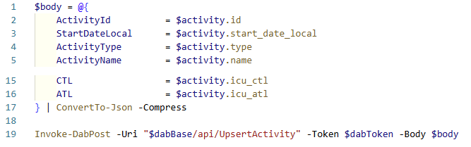
IntervalSync
Azure Function
PowerShell 7.4.
DAB is the only way in.
01
Fetch from Intervals.icu
Calls the Intervals.icu REST API to pull wellness and activity data — HRV, training load, calories burned.
02
Token via managed identity
Gets a bearer token via the function’s MSI.
Role: DAB.Access.
No client secrets stored anywhere.
03
POST to DAB
Sends data to the DAB endpoint.
DAB validates and writes to Azure SQL.
The function never touches the database directly.
Notes:
My Azure Function is running PowerShell to grab data from intervals.icu via Rest API calls… and then POST that data to DAB
Again we’re making use of managed identity – this time the Azure Function App (which is where my Azure Function lives) has a managed identity – that allows us to give that Function access to Entra to get tokens
As we said you can configure role based access controls to determine which endpoints the function can call
I have a wrapper function that handles error handling, but basically throw JSON at the endpoint

Slide 38
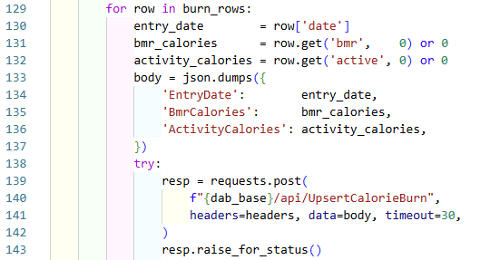
The schedule
Kubernetes CronJob.
Python script.
Pushes calories to Azure SQL via DAB.
01
Kubernetes CronJob
A CronJob on the Kubernetes cluster fires on a fixed schedule and spins up a fresh pod for each run — no long-running service to babysit.
02
Python sync to DAB
The pod runs a Python script. That reads daily calorie totals and pushes them to Azure SQL via DAB.

Slide 42
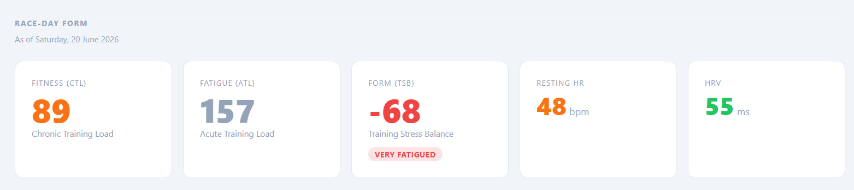
Wellness dashboard
Static Web App.
DAB is the only backend.
01
Azure Static Web App
Deployed from GitHub. Served from global CDN. No server to manage, no infrastructure to patch.
02
Reads from DAB directly
JavaScript calls the DAB REST endpoint with a bearer token. OData filtering, pagination — that’s it.
03
No separate API layer
DAB handles auth, filtering, and data access. The dashboard is pure HTML, CSS, and JS.

Slide 43
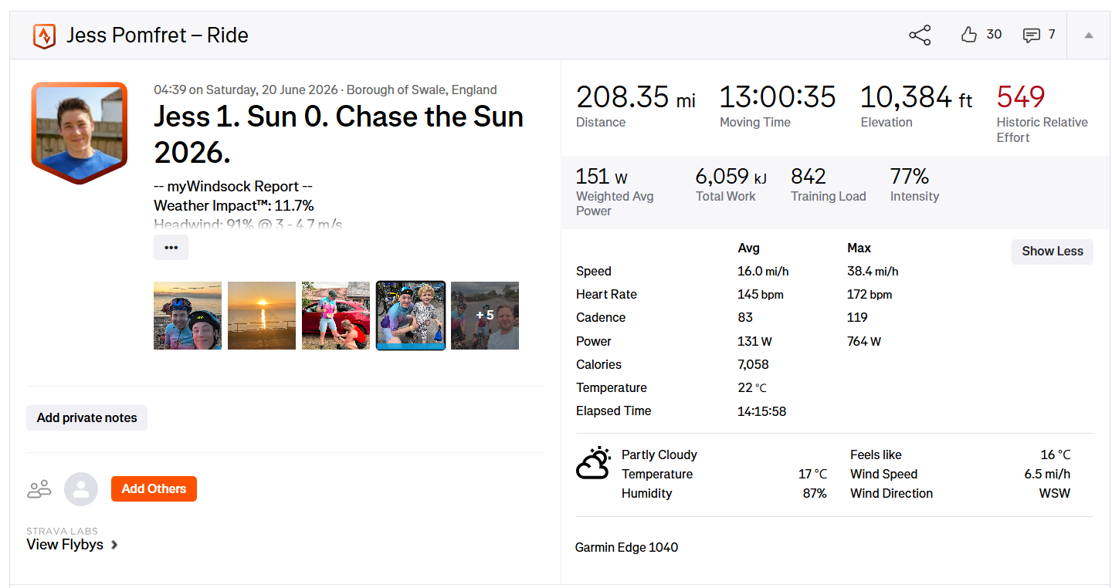
Hold on – Back to the Story…
Notes:
Big number, sets up the bet. Pause. Let it land.
what a great plan 🤣
In 30 days time

Slide 44

Hold on – Back to the Story…
Notes:
Big number, sets up the bet. Pause. Let it land.
what a great plan 🤣
In 30 days time

Slide 45
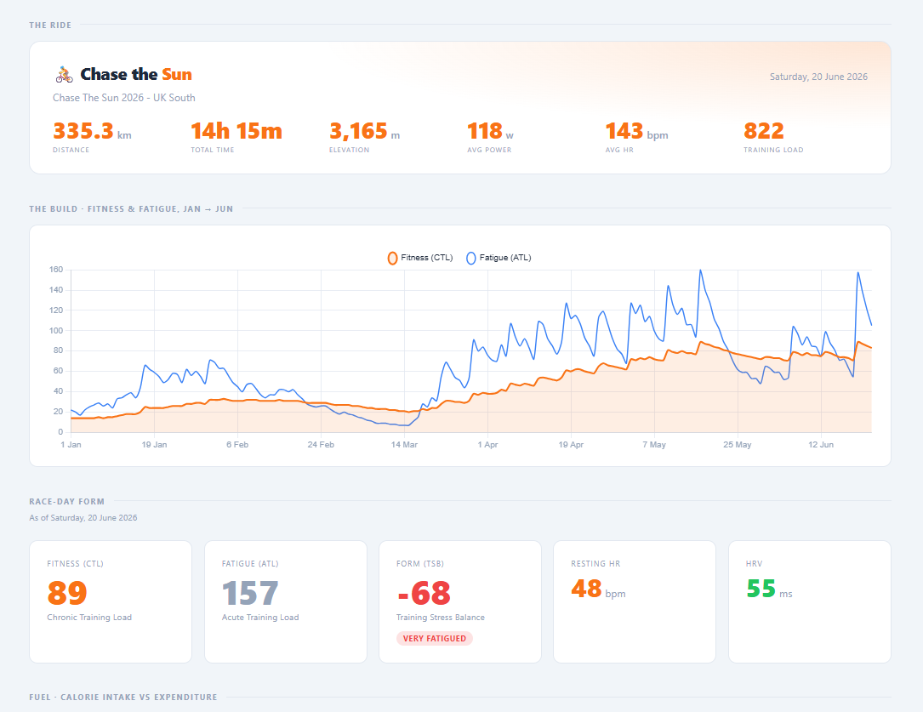
Demo: Wellness dashboard
Notes:
Go to the dashboard

Slide 46
Auto Entities
Pattern-based auto-discovery
Include/exclude with T-SQL LIKE syntax. New tables matching the pattern are exposed on each start.
Dramatically shrinks your config
No more listing every entity by hand. Multiple definitions can target different schemas with their own permissions.
CLI tooling
dab auto-config
dab auto-config-simulate
Notes:
Auto Entities is a new feature in DAB 2.0 that lets you define patterns to automatically discover and expose database objects.
Key points:
- Patterns use T-SQL LIKE syntax (e.g. dbo.% matches all objects in the dbo schema). Include and exclude arrays fine-tune which objects are exposed.
- Each autoentities definition carries its own template (REST/GraphQL/MCP toggles, caching) and permissions, so different schemas can have different access levels.
- New tables matching the pattern are picked up on each DAB restart with zero config changes.
- Currently MSSQL only.
- CLI: dab auto-config creates definitions; dab auto-config-simulate previews matches before committing.
- When autoentities is present the entities section is optional. Both can coexist; explicit entities take precedence.

Slide 47
SQL MCP Server
AI agents meet your SQL database—safely
Agents interact through MCP tools and a controlled contract—not raw SQL.
NL2DAB, not NL2SQL
Deterministic T-SQL via the DAB query builder. No schema leaks.
Same RBAC, caching & OpenTelemetry
One config drives MCP, REST, and GraphQL simultaneously.
Notes:
SQL MCP Server is built into Data API builder starting from version 1.7. It exposes database operations as a small family of MCP tools so AI agents can interact with your data through a controlled contract rather than raw SQL.
NL2DAB, not NL2SQL – The key design decision. Models are not deterministic, and complex queries are the most likely to produce subtle errors. Instead of letting agents generate free-form SQL, SQL MCP Server uses DAB’s entity abstraction layer and the built-in Query Builder to produce accurate, well-formed T-SQL in a fully deterministic way. This removes the risk associated with NL2SQL while preserving reliability for agent-generated queries.
Entity abstraction – The internal database schema is never exposed to agents. You define entities, alias fields, set relationships, and apply permissions at the API layer. This prevents schema leaks and lets you evolve the database independently of the agent interface.
DML only, no DDL – SQL MCP Server is designed to work with data (Create, Read, Update, Delete, and stored procedure execution), not schema. Agents cannot alter tables or create objects. This aligns with production use cases where AI interacts with mission-critical systems.
Same security and telemetry – RBAC, L1/L2 caching, and OpenTelemetry apply identically across REST, GraphQL, and MCP endpoints. MCP tool execution appears in the same dashboards and trace IDs as API traffic. No extra configuration required.
Two transports – Streamable HTTP for standard hosted scenarios (e.g. App Service, containers), and stdio for local development where VS Code manages the DAB process directly. Both use the same DAB config file that also drives REST and GraphQL.
SQL MCP Server implements MCP protocol version 2025-06-18. It supports SQL Server, Azure SQL, PostgreSQL, Azure Cosmos DB, and MySQL. A single DAB configuration can expose MCP, REST, and GraphQL endpoints simultaneously from one runtime.

Slide 48

Resources
Docs: aka.ms/dab
DAB Repo: github.com/Azure/data-api-builder
Demos: github.com/jpomfret/dab-presentation
jesspomfret.com
LinkedIn: jpomfret

Slide 49
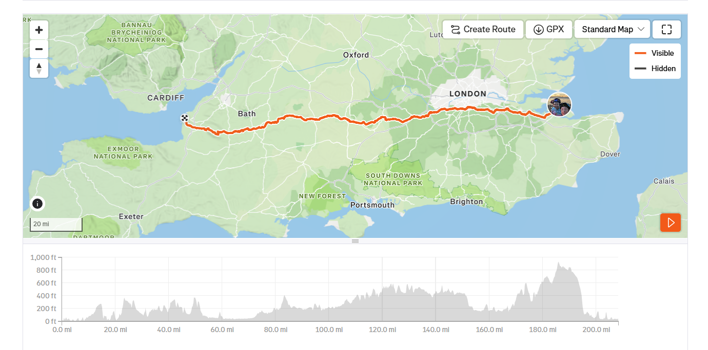
Feedback & Questions
Thank you.

Slide 50
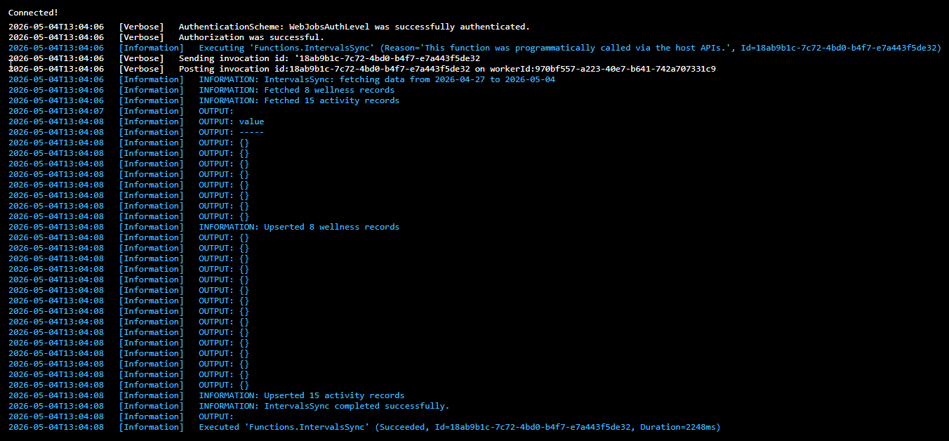

Slide 52
When not to reach for DAB
Heavy business logic — keep it in the database or a real backend.
Public-facing at scale — auth and rate limits need real thought.
Shaped responses — reach for a view or a sproc.
Multi-tenant separation — design it into the schema.

Slide 53
What it isn't
Not an ORM.
Not a full backend framework.
Not a replacement for your stored procs.
Not magic — auth, rate limits, business logic still need thinking about.
Notes:
Live demo part two. Show the schedule view, walk through how planned TSS compares to actual TSS, and the projection out to 13 June.

Slide 54
Relationships & GraphQL
Define relationships in the config file — DAB maps foreign keys and exposes nested data automatically.
One request returns parent + children — no client-side joins, no N+1 queries.
The GraphQL endpoint lets callers ask for exactly what they need — nested fields, aliases, fragments.
{ athletes(filter: {team: {eq: "A"}}) { name, activities { date, type, distance } } }
Notes:
Relationships & GraphQL — nested data without custom code
Relationships:
- Defined in the config file under each entity's "relationships" section.
- You specify the source and target entities, the linking columns, and the cardinality (one-to-many, many-to-one).
- DAB generates the join logic — no stored procedures, no views required.
- One API call returns parent + child records together — eliminates N+1 query patterns on the client.
GraphQL endpoint:
- DAB auto-generates a full GraphQL schema from your entity definitions.
- Callers request exactly the fields they need — no over-fetching, no under-fetching.
- Supports nested queries that follow the relationships you defined — e.g., query an athlete and get their activities in one request.
- Supports aliases, fragments, and introspection out of the box.
- The GraphQL endpoint lives at /graphql on the same host as the REST endpoint.
When to use REST vs GraphQL:
- REST is simpler and works with any HTTP client — good for CRUD and straightforward queries.
- GraphQL shines when the client needs flexible field selection or traverses relationships — fewer round-trips, exactly the data shape you want.
- Both endpoints are always available simultaneously — no need to choose one at deploy time.
Demo tip: show the GraphQL playground at /graphql — it has auto-complete and schema docs built in. Let the audience explore the schema interactively.

